Slide 1



CONVOLUTION CODES
INTRODUCTION TO COMMUNICATION SYSTEMS
CT-216
Prof. YASH VASAVADA
GROUP - 2, SUBGROUP - 2
DA-IICT | 2024

Slide 2
1
HONOR CODE
We declare that :
The work that we are presenting is our own work.
We have not copied the work (the code,the results,etc.) that someone else has done.
Concepts,understanding and insights we will be describing are our own.
We make this pledge truthfully. We know that violation of
this solemn pledge can carry grave consequences.
DA-IICT | 2024

Slide 3










2
GROUP MEMBER
1) Janvi Ramani - 202201158
2) Shyam Ghetiya - 202201161
3) Nishil Patel - 202201166
4) Tathya Prajapati - 202201170
5) Sunil Rathva - 202201177
6) Vedant Savani - 202201178
7) Nitin Kanzariya - 202201181
8) Akshat Joshi - 202201185
9) Bansi Patel - 202201190
10) Bhoomish Patel - 202201414
DA-IICT | 2024

Slide 4
3
CONTENT
01
INTRODUCTION : WHAT IS CONVOLUTIONAL CODING ?
07
SOFT DECISION DECODING
02
CONVOULTIONAL ENCODING
08
PSUEDO CODE
09
GRAPH , RESULTS , EXPLANATION
03
REPRESENTATION
ADVANTAGES OF CONVOLUTIONAL CODING
10
04
TRANSFER FUNCTION
11
REFERENCES
05
BPSK AND AWGN CHANNEL
06
HARD DECISION DECODING
DA-IICT | 2024

Slide 5
4
INTRODUCTION
Convolutional codes are introduced by Peter Elias in 1955 .
There were two main categories of Error Correction (ECC) codes one is Block codes and other is Convolution codes.
Convolutional codes doesn’t have a finite block like Block codes because here we give input as stream not as a block.
Convolution coding is a popular error-correcting coding method used to improve the reliability of communication system.
DA-IICT | 2024

Slide 6
5
INTRODUCTION
Convolution codes
Linear Block codes
In Convolutional codes, information
bits aren't followed by parity bit but
are spread across the sequence.
In Linear Block codes, info bits are right away followed by the parity bits.
Block codes transform a bunch of input bits into a bunch of output bits where both sets can be quite large, with k being the number of message bits.
Convolutional codes use a few input bits to generate a few output bits for each interval (when K=1).
The encoding of the current state is linked to the previous state and past elements, so it includes a memory element to store previous state information.
The encoding of the current state doesn't rely on the previous state, so it lacks any memory element. It only hinges on the current message bit.
DA-IICT | 2024

Slide 7

6
FLOW OF BPSK & AWGN CHANNEL WITH
CONVOLUTION﻿ ENCODING
input message(m)
convolution encoding
Codeword (c)
BPSK
Modulation
Symbol(S)
+
Noise
AWGN Noise
Final output
Codeword (c)
Decoder
Demodulation
Received message (S + N)
DA-IICT | 2024

Slide 8
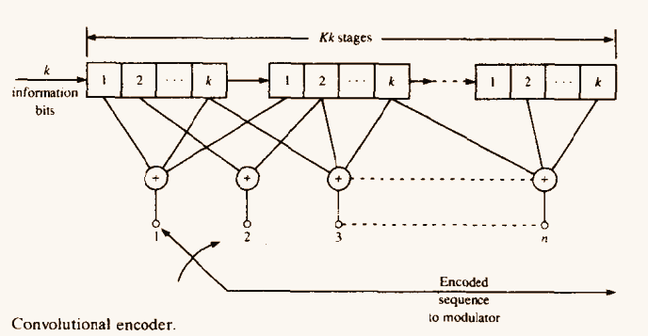
7
ENCODING
Convolution codes are characterized by three parameters (n,k,m)
n = number of output bits produced for each k-bit sequence
k = number of input bits
m = number of memory registers
Code Rate (R) = k/n
DA-IICT | 2024

Slide 9
8
ENCODING REPRESENTATION
There are some types of convolution encoding represantation
State Diagram reprensatation
Tree Diagram represantation
Trellis represantation
DA-IICT | 2024

Slide 10

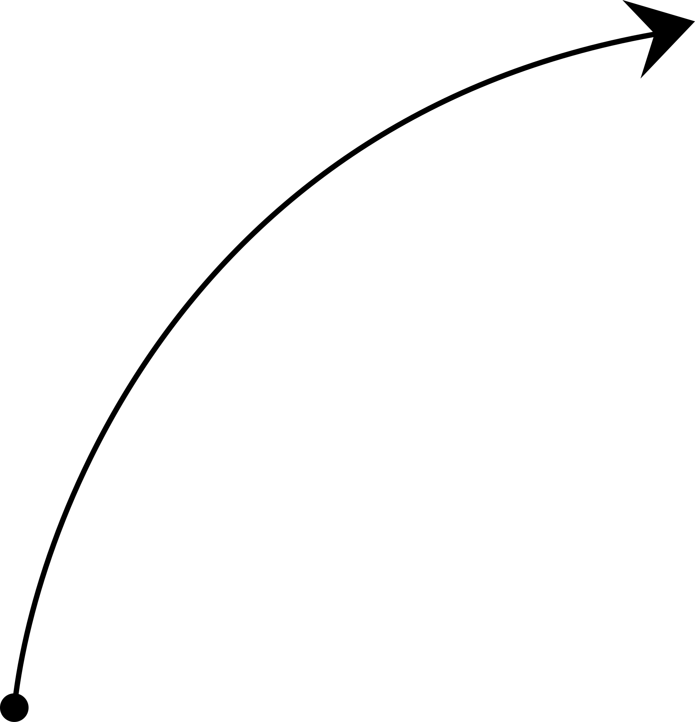

STATE DIAGRAM
9
R = 1/2 , Kc = 3, g1 = [1 0 1] , g2= [1 1 1]
0/00
input data bit
00
0/11
1/11
Corresponding output code bits
1/00
01
10
(Kc-1)
0/01
2
= 4 total states
0/10
1/10
11
1/01
DA-IICT | 2024

Slide 11
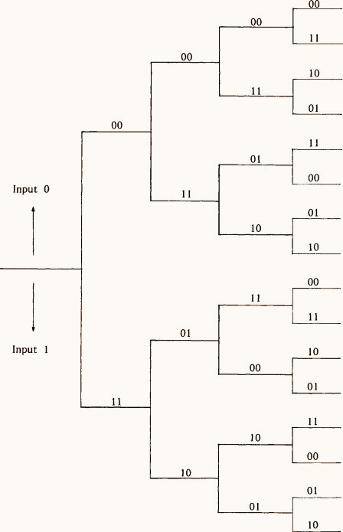
TREE DIAGRAM
10
R = 1/2 , Kc = 3, g1 = [1 0 1] , g2= [1 1 1]
Video lectures on Convolutional coding by Subhramanyam K N :
https://shorturl.at/hZ136
DA-IICT | 2024

Slide 12
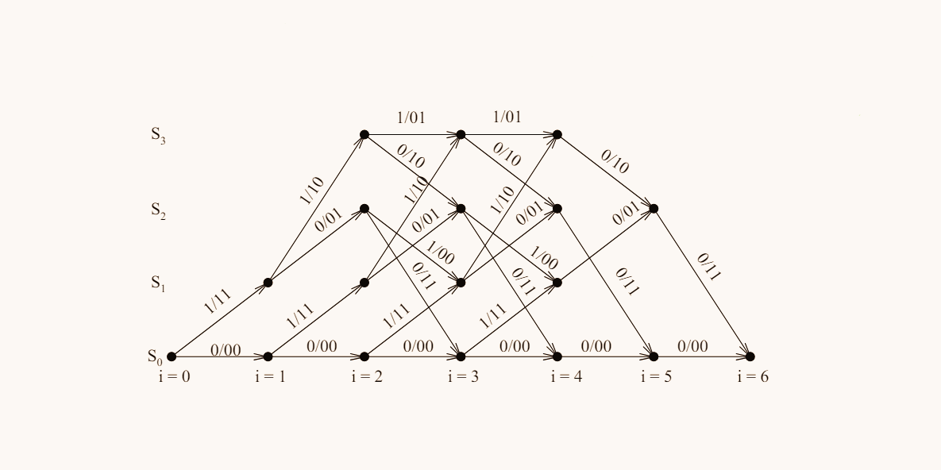
Trellis Representation
11
R = 1/2 , Kc = 3, g1 = [1 0 1] , g2= [1 1 1]
CT216. Introduction to communication system:Channel Coding for IEEE 802.16e Mobile WiMAX by prof. Matthew C. Valenti .
DA-IICT | 2024

Slide 13
Transition Table
12
R = 1/2 , Kc = 3, g1 = [1 0 1] , g2= [1 1 1]
Input | Current State | Next State
0 | 00 | 00
1 | 00 | 10
0 | 01 | 00
Register Content | o1 | o2
000 | 0 | 0
100 | 1 | 1
001 | 1 | 1
1 | 01 | 10
0 | 10 | 01
1 | 10 | 11
0 | 11 | 01
1 | 11 | 11
101 | 0 | 0
010 | 0 | 1
110 | 1 | 0
011 | 1 | 0
111 | 0 | 1
DA-IICT | 2024

Slide 14



13
ENCODING
For Input: [1 0 1 0]
1
At t=1,
1
0
1
0
INPUT
OUTPUT
0
0
1
DA-IICT | 2024

Slide 15
14
ENCODING
At t=2,
1
1
0
1
0
INPUT
OUTPUT
1
0
1
1
0
DA-IICT | 2024

Slide 16
15
ENCODING
At t=3,
0
1
0
1
0
INPUT
OUTPUT
0
1
1
1
1
0
0
DA-IICT | 2024

Slide 17
16
ENCODING
At t=4,
1
1
0
1
0
INPUT
OUTPUT
1
0
1
1
1
0
0
0
0
DA-IICT | 2024

Slide 18
17
ENCODING
1
0
1
0
INPUT
OUTPUT
0
1
1
1
1
0
0
0
1
0
DA-IICT | 2024

Slide 19
18
ENCODING
The extra ‘0’ bits added till register will get reset
1
At t=5,
1
0
1
0
0
INPUT
OUTPUT
0
1
1
1
1
0
0
0
1
0
1
DA-IICT | 2024

Slide 20
19
ENCODING
At t=6,
0
1
0
1
0
0
0
INPUT
OUTPUT
0
0
1
1
1
0
0
0
1
0
1
1
0
DA-IICT | 2024

Slide 21
20
ENCODING
1
0
1
0
0
0
INPUT
OUTPUT
0
0
1
1
1
0
0
0
1
0
1
1
0
0
Input: [1 0 1 0]
Actual Output: [1 1 1 0 0 0 1 0]
Output: [1 1 1 0 0 0 1 0 1 1 0 0]
DA-IICT | 2024

Slide 22


21
TRANSFER FUNCTION
In convolutional coding, a transfer function describes how the input and output of a convolutional encoder are related. It's a useful tool for analyzing the performance of convolutional codes.
a
D
d
f(d)
g(d)
N
J
T (D, N, J) =
d
d = d
free
Exponent of J - g(d) - The length of the path that merges with the all zero path for the first time.
Exponent of N - f(d) - The number of ones in the input sequence of K- bits.
Exponent of D - d - The number of ones in the output sequence
DA-IICT | 2024

Slide 23
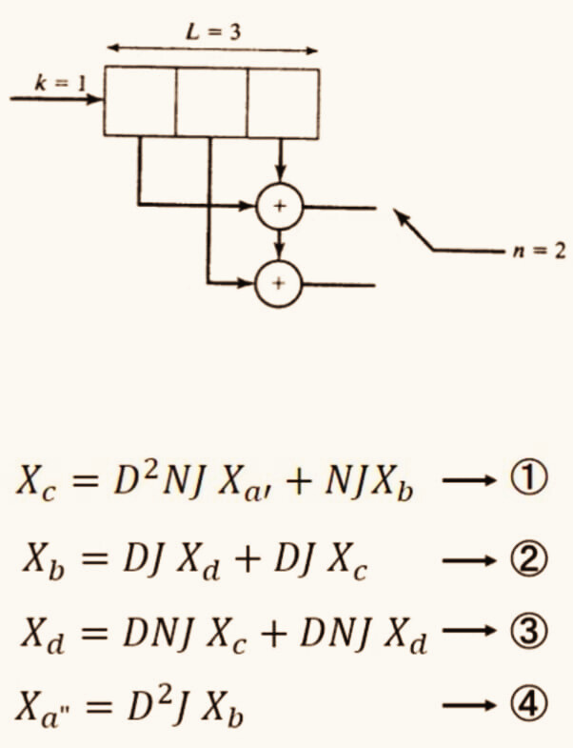
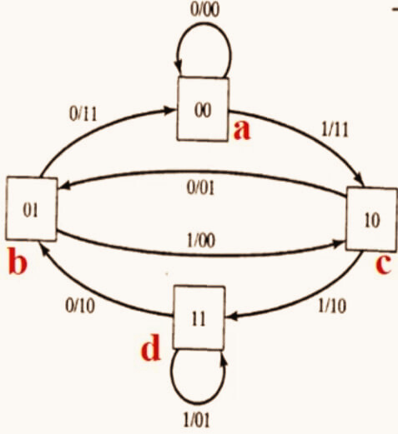
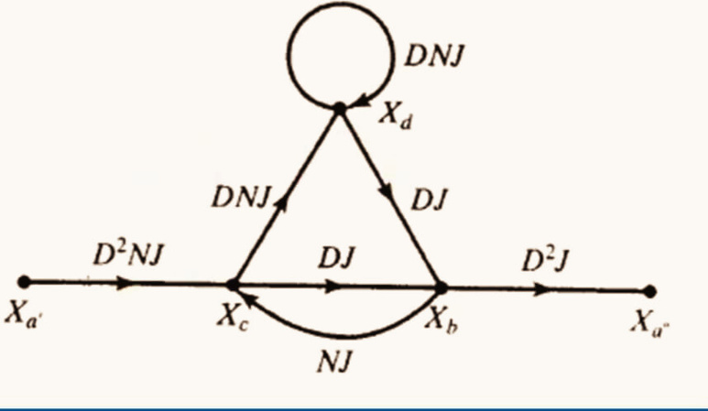
22
For R=1/2 , k=1, n=2
Video lectures on Convolutional coding by Subhramanyam K N :
https://shorturl.at/hZ136
DA-IICT | 2024

Slide 24
23
For R=1/2, k=1, n=2
T (D, N, J) = D
5
3
6
2
4
6
2
5
7
3
N
J
+ D
N
J
+ D
N
J
+ D
N
J
5
+
...
2
4
2
X
D
J
X
D
N
J
X
a
”
b
=
b
,
=
X
1
( X
- N J X
)
( X
- N J X
)
a
c
b
c
b
2
D
N
J
X
D
5
N
J
3
a
”
,
=
2
X
( 1 - D N J - D N J
)
a
Properties of transfer function :-
Provides the properties of all the paths
Minimum non-zero exponent of D gives the minimum hamming distance
DA-IICT | 2024

Slide 25
24
BPSK (Binary Phase Shift Keying)
BPSK modulation efficiently transmits digital data by altering the phase of a carrier signal.
A binary 0 is represented by a phase shift of 180 degrees, while a binary 1 is represented by no phase shift in the carrier signal.
This straightforward technique enables efficient transmission of digital data.
It is also utilized in different wireless communication systems like Wi-Fi, Bluetooth, and satellite communication.
BPSK
1
-1
0
1
DA-IICT | 2024

Slide 26
25
AWGN(Additive white Gaussian Noise)
Each letter in the AWGN helps explain what the term means :
Additive : AWGN channel, noise gets mixed in the original signal as it travels through the communication channel.
White : The term “white” is in reference to the noise having the same power distribution across every frequency.
Gaussian : Gaussian noise follows a Gaussian distribution, also known as a normal distribution. This means that the noise values are randomly distributed around a mean value with a certain standard deviation, following the bell-shaped curve characteristic of a Gaussian distribution.
DA-IICT | 2024

Slide 27
26
MODULATION OVER AWGN CHANNEL
n(t)
a
s(t)
r(t)
^
BPSK
Modulation
a
AWGN Noise
Demodulation
a = Encoded transmitted bits
^
= Receiver’s estimated value of this transmitted bit
a
s(t) = Waveform transmitted into the channel
n(t) = White Gassian Noise
r(t) = s(t) + n(t): Waveform of received after addition of noise
DA-IICT | 2024

Slide 28
27
DECODING
Hard Decision Decoding :- Hard Decision decoding works on principle of Minimum Hamming Distance.
Soft Decision Decoding :- Soft Decision Decoding works on the principle of Minimum Euclidean Distance.
Decoding in convolutional code :-
There are two types of decoding techniques in convolutional coding :
DA-IICT | 2024

Slide 29
28
VITERBI DECODING(HDD)
Define States:
Define states based on the constraint length K of the convolutional code, resulting
possible states.
Initialize Trellis:
Create an empty trellis with rows for each state and columns for (encoded bits/K-1) plus one for the initial state.
Start at Initial State:
Place initial states in the leftmost column and assign a metric (typically distance) to each.
Transitioning:
For each encoded bit, calculate the Hamming distance between current and possible next states.
Choose transitions resulting in the minimum distance and update metrics accordingly.
Backtracking:
At the end of the sequence, identify the path with the lowest cumulative metric.
Final Decoded Sequence:
Backtrack through the trellis along the minimum distance path to obtain the decoded sequence.
(K - 1)
2
DA-IICT | 2024

Slide 30
VITERBI DECODING (HDD)
29
For input = [1 0 1 0], g1=[1 0 1], g2=[1 1 1]
11
10
00
10
11
00
00
0
00
00
00
0
00
00
00
11
11
11
11
11
11
11
11
11
11
11
11
01
00
00
00
00
00
00
01
01
01
01
01
01
10
10
10
10
10
10
10
10
10
10
10
10
10
11
01
01
01
01
01
01
DA-IICT | 2024

Slide 31
VITERBI DECODING (HDD)
30
For input = [1 0 1 0], g1=[1 0 1], g2=[1 1 1]
11
10
00
10
11
00
00
0
2
2
00
00
0
2
00
00
00
11
11
11
11
11
0
11
11
11
11
11
11
01
00
00
00
00
00
00
01
01
01
01
01
01
10
0
10
10
10
10
10
10
10
10
10
10
10
10
11
01
01
01
01
01
01
DA-IICT | 2024

Slide 32
VITERBI DECODING (HDD)
31
For input = [1 0 1 0], g1=[1 0 1], g2=[1 1 1]
11
10
00
10
11
00
00
0
2
2
1
00
0
2
3
00
00
00
11
11
11
11
0
1
11
11
11
11
11
11
01
2
00
00
00
00
00
00
2
01
01
01
01
01
10
0
3
10
0
10
10
10
10
10
10
10
10
10
10
11
0
01
01
01
01
01
01
DA-IICT | 2024

Slide 33
VITERBI DECODING (HDD)
32
For input = [1 0 1 0], g1=[1 0 1], g2=[1 1 1]
11
10
00
10
11
00
00
0
2
2
1
0
3
0
2
3
00
00
00
11
11
11
0
1
2
11
11
11
11
11
11
01
2
00
00
00
00
00
00
2
01
01
01
01
01
10
0
3
5
10
0
10
10
10
10
10
10
10
10
10
10
11
0
01
01
01
01
01
01
DA-IICT | 2024

Slide 34
VITERBI DECODING (HDD)
33
For input = [1 0 1 0], g1=[1 0 1], g2=[1 1 1]
11
10
00
10
11
00
00
0
2
2
1
0
3
0
2
3
00
00
00
11
11
11
0
1
2
11
11
2
11
11
01
2
0
00
00
00
00
00
2
2
01
01
01
01
01
10
0
3
11
5
10
0
10
10
10
10
10
10
10
10
10
10
11
0
01
01
01
01
01
01
DA-IICT | 2024

Slide 35
VITERBI DECODING (HDD)
34
For input = [1 0 1 0], g1=[1 0 1], g2=[1 1 1]
11
10
00
10
11
00
00
0
2
2
1
0
3
0
2
3
00
00
00
11
11
11
11
0
1
11
11
11
11
11
11
01
2
1
00
00
0
00
00
00
2
01
01
01
01
01
10
0
3
2
10
0
10
10
10
10
10
10
1
10
10
10
11
0
1
01
01
1
01
01
01
DA-IICT | 2024

Slide 36
VITERBI DECODING (HDD)
35
For input = [1 0 1 0], g1=[1 0 1], g2=[1 1 1]
11
10
00
10
11
00
00
0
2
2
1
0
3
0
2
3
00
2
00
00
11
11
11
11
0
1
11
11
11
1
11
11
01
2
1
1
00
00
0
1
00
00
2
01
01
01
01
01
10
0
3
2
2
0
0
10
10
10
10
10
10
1
0
10
10
11
0
1
2
01
01
1
01
01
01
DA-IICT | 2024

Slide 37
VITERBI DECODING (HDD)
36
For input = [1 0 1 0], g1=[1 0 1], g2=[1 1 1]
11
10
00
10
11
00
00
0
2
2
1
0
3
00
1
0
2
3
00
2
00
11
11
0
11
0
1
11
11
11
1
0
11
01
2
1
1
3
00
00
0
1
00
00
2
01
01
01
1
01
10
0
3
2
2
2
0
0
10
10
1
10
10
10
1
0
10
10
11
0
1
2
3
01
01
1
01
01
01
DA-IICT | 2024

Slide 38
VITERBI DECODING (HDD)
37
For input = [1 0 1 0], g1=[1 0 1], g2=[1 1 1]
11
10
00
10
11
00
00
0
2
2
1
0
3
00
1
0
1
0
2
3
00
2
11
11
0
11
0
1
11
11
11
1
0
11
01
2
1
1
3
00
00
0
1
00
00
2
01
01
01
1
01
10
0
3
2
2
2
0
0
10
10
1
10
10
10
1
0
10
10
11
0
1
2
3
01
01
1
01
01
01
DA-IICT | 2024

Slide 39
VITERBI DECODING (HDD)
38
For input = [1 0 1 0], g1=[1 0 1], g2=[1 1 1]
11
10
00
10
11
00
00
0
1
0
1
0
0
0
01
1
0
10
0
0
11
0
1
1
DA-IICT | 2024

Slide 40
39
VITERBI DECODING(SDD)
Construct the trellis diagram.
Calculate Euclidean Distances:
Extract blocks of size n from the received message and determine the Euclidean distances with the state outputs.
For distance computation, modulate the state outputs, square the differences between corresponding bits, and sum these values.
Evaluate Branch Metrics:
Nodes with multiple incoming branches require computation of individual branch metrics.
Assess and compare these metrics to identify the minimum metric for each node.
Update Node Metrics:
Revise the node metrics using the minimum branch metrics obtained.
Perform Backtracking:
Upon reaching the trellis's end, backtrack along the path with the minimum path metric or Euclidean distance to ascertain the decoded output.
DA-IICT | 2024

Slide 41
40
PSUEDO CODE : ENCODING
FUNCTION encoding(kc, generation_polynomials, inp)
// Initialize variables
n = LENGTH(generation_polynomials) // Number of generation polynomials
ans = [] // Initialize empty list for storing results
regval = 0 // Initialize register value to zero
// Loop through each input bit
FOR i FROM 1 TO LENGTH(inp)
curbit = inp[i] // Get current input bit
regval = BITOR(BITSHIFT(regval, -1), BITSHIFT(curbit, (kc - 1))) // Update register value
// Loop through each generation polynomial
FOR j FROM 1 TO n
cur_poly = generation_polynomials[j] // Get current generation polynomial
output = 0 // Initialize output to zero
p = DEC2BIN(cur_poly, kc) // Convert current polynomial to binary
|
|
|
|
|
|
|
|
rv = DEC2BIN(regval, kc) - '0' // Convert register value to binary
output = 0 // Initialize output to zero
// Compute output using bitwise AND and XOR operations
FOR k FROM 1 TO kc
output = XOR(output, (p[k] AND rv[k])) // Update output using XOR and AND operations
END FOR
ans = CONCATENATE(ans, output) // Append output to result list
END FOR
END FOR
RETURN ans // Return the encoded output
END FUNCTION
DA-IICT | 2024

Slide 42
41
PSUEDO CODE : HARD DECODING
FUNCTION decoding(kc, generation_polynomials, inp)
// Initialize variables
ns = BITSHIFT(1, (kc - 1)) // Number of states
n = LENGTH(generation_polynomials) // Number of generation polynomials
mtr = ONES(FLOOR(LENGTH(inp) / n) + 1, ns) * 1e9 // Initialize metric matrix with large values
previous_states = CELL(FLOOR(LENGTH(inp) / n) + 1, 1) // Initialize previous states cell array
// Initialize previous_states with large values
FOR i FROM 1 TO LENGTH(previous_states)
previous_states[i] = CELL(ns, 1)
FOR j FROM 1 TO ns
previous_states[i][j] = {1e9, 1e9}
END FOR
END FOR
idx = 0
|
|
|
|
|
|
|
|
// Loop through time instances
FOR t FROM 1 TO (LENGTH(inp) / n)
// Loop through states
FOR st FROM 0 TO ns - 1
// Initialize metric for the first time instance and state 0
IF (t == 1) AND (st == 0)
mtr(t, st + 1) = 0
END IF
// Loop through input bits (0 and 1)
FOR input_bits FROM 0 TO 1
curstate = st
next_state = BITOR(BITSHIFT(curstate, -1), (input_bits * BITSHIFT(
1, (kc - 2))))
hamming_distance = 0
// Compute output and update hamming distance
FOR i FROM 1 TO n
output = 0
poly = generation_polynomials[i]
regvalue = BITOR(curstate, BITSHIFT(input_bits, (kc - 1)))
DA-IICT | 2024

Slide 43
42
PSUEDO CODE : HARD DECODING
FOR k FROM 0 TO (kc - 1)
output = BITXOR(output, BITAND(BITSHIFT(poly, -k), 1) AND BITAND(BITSHIFT(regvalue, -(k), 1))
END FOR
// Update hamming distance
IF output != inp(idx + i)
hamming_distance = hamming_distance + 1
END IF
END FOR
a = mtr(t + 1, next_state + 1)
b = mtr(t, curstate + 1)
// Update metric and previous states
IF a > b + hamming_distance
mtr(t + 1, next_state + 1) = b + hamming_distance
previous_states[t + 1][next_state + 1] = {curstate, input_bits}
END IF
|
|
|
|
|
|
|
|
END FOR
END FOR
idx = idx + n
END FOR
// Initialize ans list
ans = []
// Trace back to find the optimal path
temp = previous_states[(LENGTH(inp) / n) + 1][1]
ans = [temp[2] ans]
cur = LENGTH(inp) / n
WHILE cur > 1
temp = previous_states[cur][temp[1] + 1]
ans = [temp[2] ans]
cur = cur - 1
END WHILE
RETURN ans // Return the decoded output
END FUNCTION
DA-IICT | 2024

Slide 44
43
PSUEDO CODE : SOFT DECODING
FUNCTION decoding_soft(kc, generation_polynomials, inp)
// Initialize variables
ns = BITSHIFT(1, (kc - 1)) // Number of states
n = LENGTH(generation_polynomials) // Number of generation polynomials
mtr = ONES(FLOOR(LENGTH(inp) / n) + 1, ns) * 1e9 // Initialize metric matrix with large values
previous_states = CELL(FLOOR(LENGTH(inp) / n) + 1, 1) // Initialize previous states cell array
// Initialize previous_states with large values
FOR i FROM 1 TO LENGTH(previous_states)
previous_states[i] = CELL(ns, 1)
FOR j FROM 1 TO ns
previous_states[i][j] = {1e9, 1e9}
END FOR
END FOR
idx = 0
|
|
|
|
|
|
|
|
// Loop through time instances
FOR t FROM 1 TO (LENGTH(inp) / n)
// Loop through states
FOR st FROM 0 TO ns - 1
// Initialize metric for the first time instance and state 0
IF (t == 1) AND (st == 0)
mtr(t, st + 1) = 0
END IF
// Loop through input bits (0 and 1)
FOR input_bits FROM 0 TO 1
curstate = st
next_state = BITOR(BITSHIFT(curstate, -1), (input_bits * BITSHIFT(1, (kc - 2))))
euclidean_distance = 0
// Compute output and update euclidean distance
FOR i FROM 1 TO n
output = 0
poly = generation_polynomials[i]
regvalue = BITOR(curstate, BITSHIFT(input_bits, (kc - 1)))
DA-IICT | 2024

Slide 45
44
PSUEDO CODE : SOFT DECODING
// Compute output using bitwise operations
FOR k FROM 0 TO (kc - 1)
output = BITXOR(output, BITAND(BITSHIFT(poly, -k), 1) AND BITAND(BITSHIFT(regvalue, -(k)), 1))
END FOR
output = 1 - 2 * output
euclidean_distance = euclidean_distance + (ABS(output - inp(idx + i)) * ABS(output - inp(idx + i)))
END FOR
euclidean = SQRT(euclidean_distance)
a = mtr(t + 1, next_state + 1)
b = mtr(t, curstate + 1)
// Update metric and previous states
IF a > b + euclidean_distance
mtr(t + 1, next_state + 1) = b + euclidean_distance
previous_states[t + 1][next_state + 1] = {curstate, input_bits}
END IF
|
|
|
|
|
|
|
|
END FOR
END FOR
idx = idx + n
END FOR
// Initialize ans list
ans = []
// Trace back to find the optimal path
temp = previous_states[(LENGTH(inp) / n) + 1][1]
ans = [temp[2] ans]
cur = LENGTH(inp) / n
WHILE cur > 1
temp = previous_states[cur][temp[1] + 1]
ans = [temp[2] ans]
cur = cur - 1
END WHILE
RETURN ans // Return the decoded output
END FUNCTION
DA-IICT | 2024

Slide 46
45
PSUEDO CODE : MODULATION
FUNCTION modulator(encoded_message, sigma)
// BPSK modulation: Mapping binary values 1 to -1 and 0 to 1
s = 1 - 2 * encoded_message
// Add Gaussian noise to the modulated signal
modulated_op = s + sigma * RANDN(1, LENGTH(encoded_message))
RETURN modulated_op // Return the modulated signal with noise
END FUNCTION
DA-IICT | 2024

Slide 47
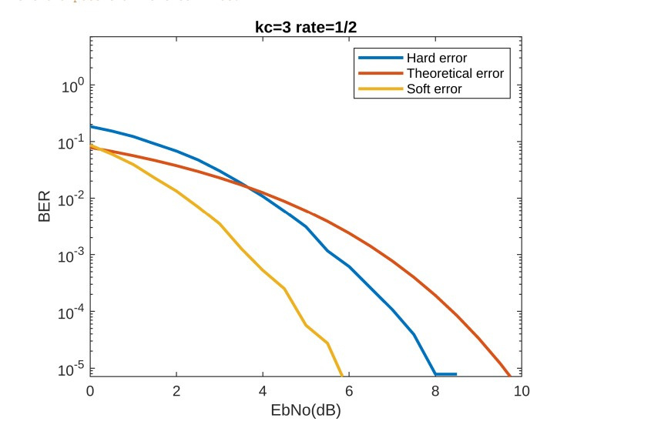
46
GRAPH : R=1/2 AND KC=3
DA-IICT | 2024

Slide 48
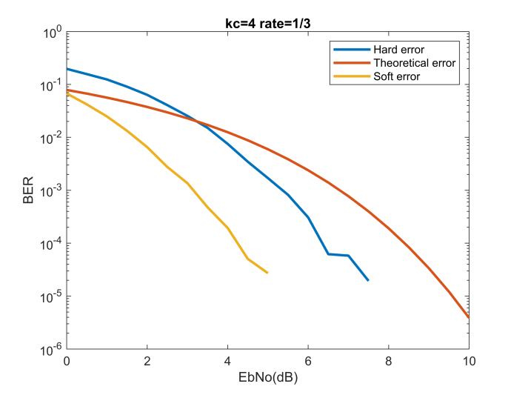
47
GRAPH : R=1/3 AND KC=4
DA-IICT | 2024

Slide 49
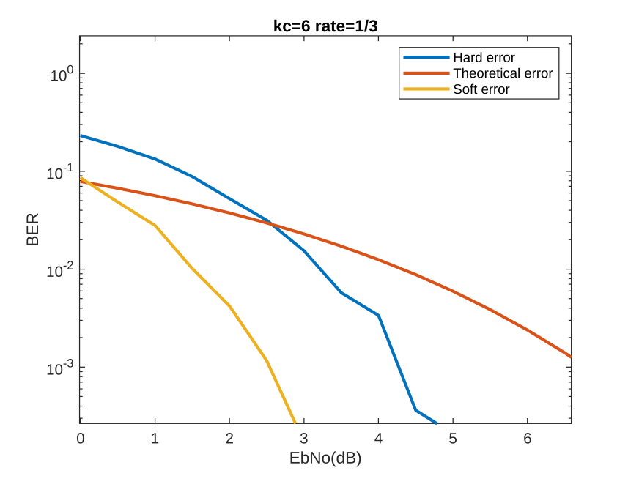
48
GRAPH : R=1/3 AND KC=6
DA-IICT | 2024

Slide 50
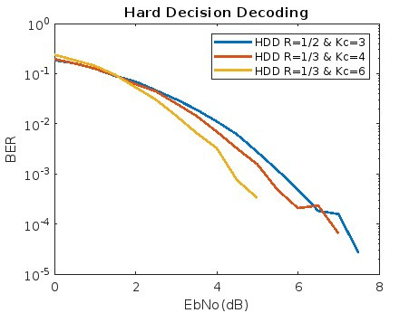
49
GRAPH : FOR ALL RATES(HDD)
DA-IICT | 2024

Slide 51
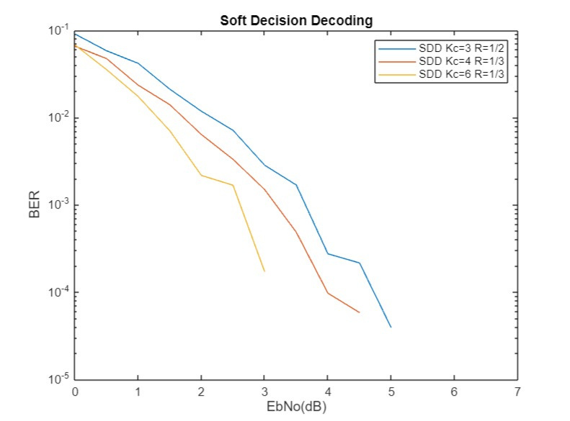
50
GRAPH : FOR ALL RATES(SDD)
DA-IICT | 2024

Slide 52
51
RESULTS AND EXPLANATION
-> The performance of the Viterbi for each hard and soft increases with an increase in SNR.
->Viterbi Soft decision decoding performs better than Viterbi Hard decision decoding.
->Bit Error Rate(BER) and Probability of Detection Error (PDE) will be high for the Lower value of SNR and will be low for the high value of SNR.
->Increasing the constraint length significantly improves error correction capabilities, but it comes at the cost of significantly higher computational complexity, leading to increased processing time.
->What are the reasons that Soft decision decoding is better than hard decision decoding?
As in hard decision decoding, each received symbol is demodulated into bits based on a set threshold, which can introduce ambiguity as the decoder might select incorrect bits due to uncertainty.
Soft decision decoding utilizes the received symbols directly, rather than demodulating them into bits. Unlike Viterbi hard decision decoding, there is no ambiguity in soft decision decoding because it works with the continuous values of the received symbols.
DA-IICT | 2024

Slide 53
52
ADVANTAGES OF CONVOLUTION CODE
Convolution coding is a technique used in digital communications to correct errors in data mistakes.
Convolutional coding performs better when you have higher probability rates and noisy channels.
Using the concept of convolutional coding scheme we are able to remove the most of the errors from the message.
Convolution coding scheme is more suitable for digital communication system because it works well in continuous transmission of data.
DA-IICT | 2024

Slide 54
53
REFERENCES
[1] Digital Communications, John G. Proakis, 4th Edition,1995.
[2] CT216. Introduction to communication system:Channel Coding for IEEE 802.16e Mobile WiMAX by prof. Matthew C. Valenti .
[3] Lectures of MIT :
https://web.mit.edu/6.02/www/f2010/handouts/lectures/L8.pdf
[4] Video lectures on Convolutional coding by Subhramanyam K N :
https://shorturl.at/hZ136
DA-IICT | 2024

Slide 55
54
GROUP MEMBERS
1) Janvi Ramani - 202201158
2) Shyam Ghetiya - 202201161
3) Nishil Patel - 202201166
4) Tathya Prajapati - 202201170
5) Sunil Rathva - 202201177
6) Vedant Savani - 202201178
7) Nitin Kanzariya - 202201181
8) Akshat Joshi - 202201185
9) Bansi Patel - 202201190
10) Bhoomish Patel - 202201414
DA-IICT | 2024

Slide 56
Thank You !

